Slide 1
The VALUABLES Framework for Measuring Socioeconomic Benefits
VALUABLES Consortium Annual Workshop
OCTOBER 30, 2019

Slide 2
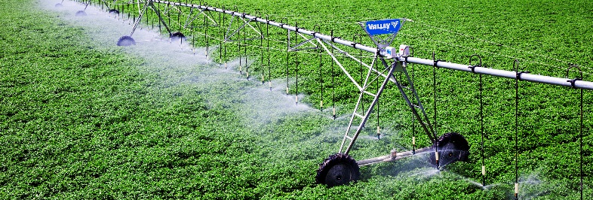
What do we mean by “socioeconomic benefits”?
Things that are beneficial to society:
Lives saved
Increase in firm profits
Increase in crop yields
Fishery collapses avoided
Things that are not beneficial to society in and of themselves:
Peer-reviewed publications
Data downloads
“Improved understanding”

Slide 3
3 basic principles about the value of information

Slide 4
#1. Information will yield societal benefits only when it influences a decision
We cannot quantify the value of information without understanding the decisions that are made with it
Need to be specific about the decision that will be informed
“An improved forecast of x can help inform water management”
vs.
“An improved forecast of x will help operators of Shasta Dam optimize the timing of releases to maintain cold water pools below the dam that are essential for salmon habitat”

Slide 5
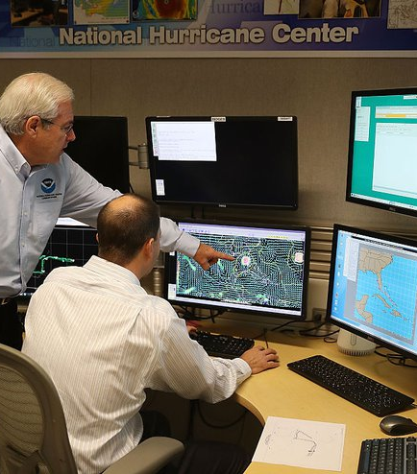
#2. When are the socioeconomic benefits of improved information likely to be large?
The improved information yields a large reduction in uncertainty
There is a lot at stake in the decision context
There are very good and very bad states of the world
Available decisionmaker actions can change outcomes

Slide 6
#3. Design a strategy to measure the societal benefits of your improved information (even if you don’t actually plan to do it)
Map the causal logic of how your improved information will produce societal benefits
Choose metrics to measure the relevant societal benefit
Design an empirical strategy to identify whether the societal benefit is realized as a result of the improved information being available

Slide 7
The VALUABLES Impact Assessment Framework

Slide 8
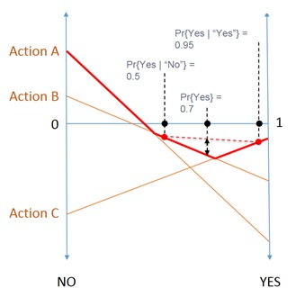
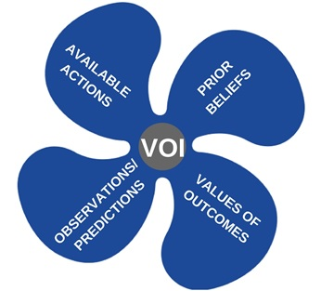
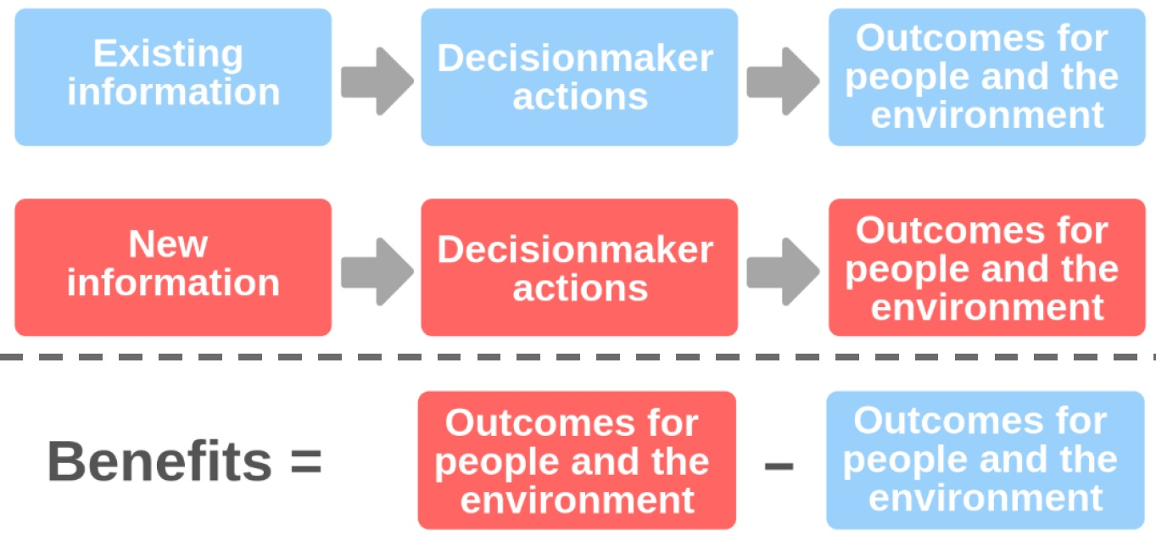
Developing the framework
Based on existing academic literature on value of information
Refined through surveys, testing, and iteration

Slide 9
The VALUABLES Impact Assessment Framework
INFORMATION
[enter text here]
[enter text here]
DECISIONMAKER ACTIONS
[enter text here]
[enter text here]
OUTCOMES FOR PEOPLE AND THE ENVIRONMENT
[enter text here]
[enter text here]

Slide 10
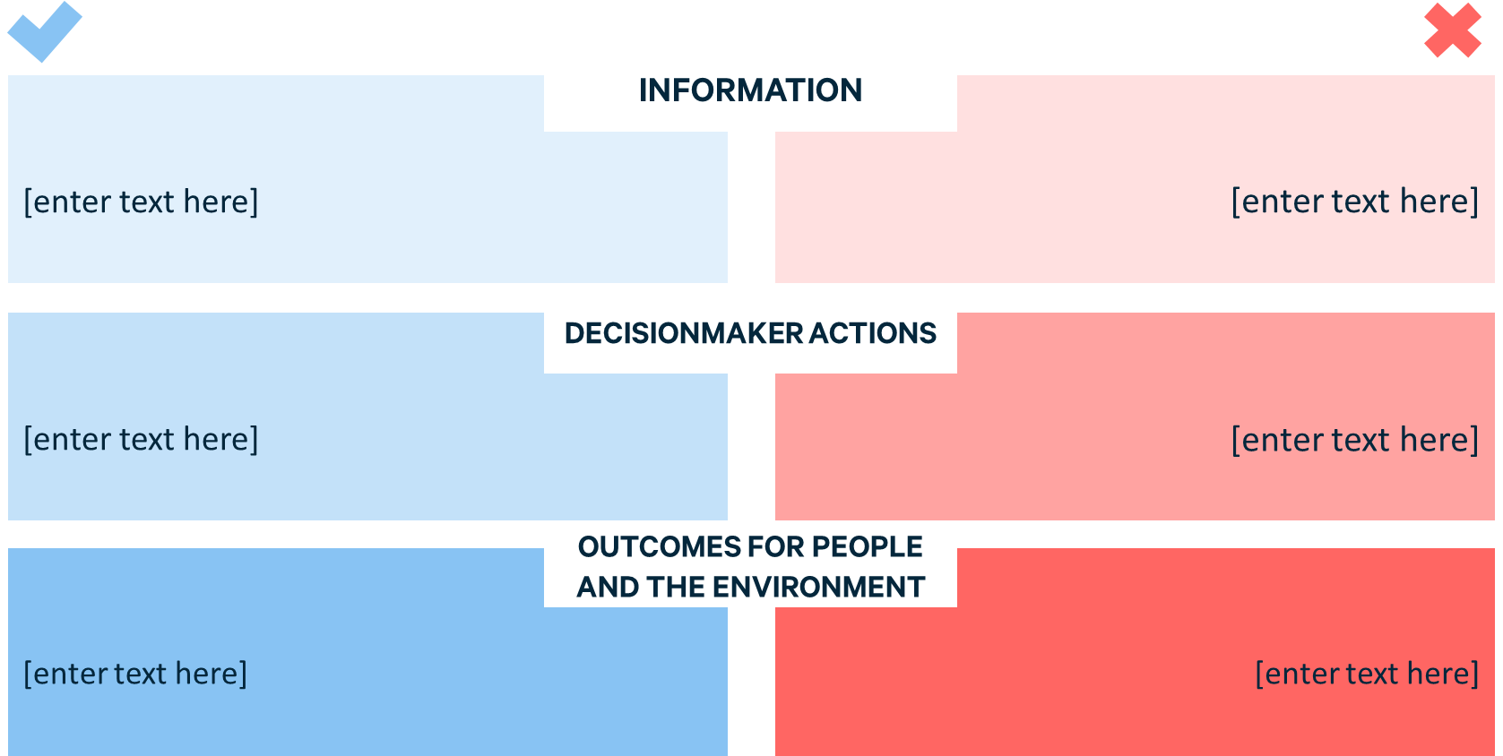
The VALUABLES IA Framework: Key implications
Impact assessments need to identify a reference case and one or more counterfactuals
Need a research plan to document differences in information, decisionmaker actions, and socioeconomic outcomes

Slide 11
VALUABLES IA Framework: Flexibility
Can accommodate ex ante and ex post impact assessments (this will determine the definition of the reference case and counterfactuals)
Differences in information, decisionmaker actions, and socioeconomic outcomes can be described quantitatively or qualitatively
Monetizing the socioeconomic value of the outcome can be useful, but not always possible (or necessary)

Slide 12
Impact assessments for Earth observations in practice

Slide 13
IAs require significant collaboration
Impact assessment team
Scientists who produce the information
Decisionmakers who use the information

Slide 14
Challenges in conducting collaborative IAs
Barriers for scientists and decisionmakers:
Supporting impact assessment teams is typically not part of their job;
Demonstrating the value of information usually involves showing that:
One source of information is better than another
A better decision could have been made
Decisionmaker should invest $ and effort in adopting a new source of information
Barrier for impact assessment teams:
Value of information is not a “hot” research topic
Difficult to achieve existing standards of empirical research
Need incentives to collaborate!

Slide 15
Thank you.
Learn more: www.rff.org/valuables/tools-resources

