Slide 1
Market-Based Methods for Monetizing Uncertainty Reduction: A Case Study
Roger Cooke and Alexander Golub
OCTOBER 30, 2019

Slide 2
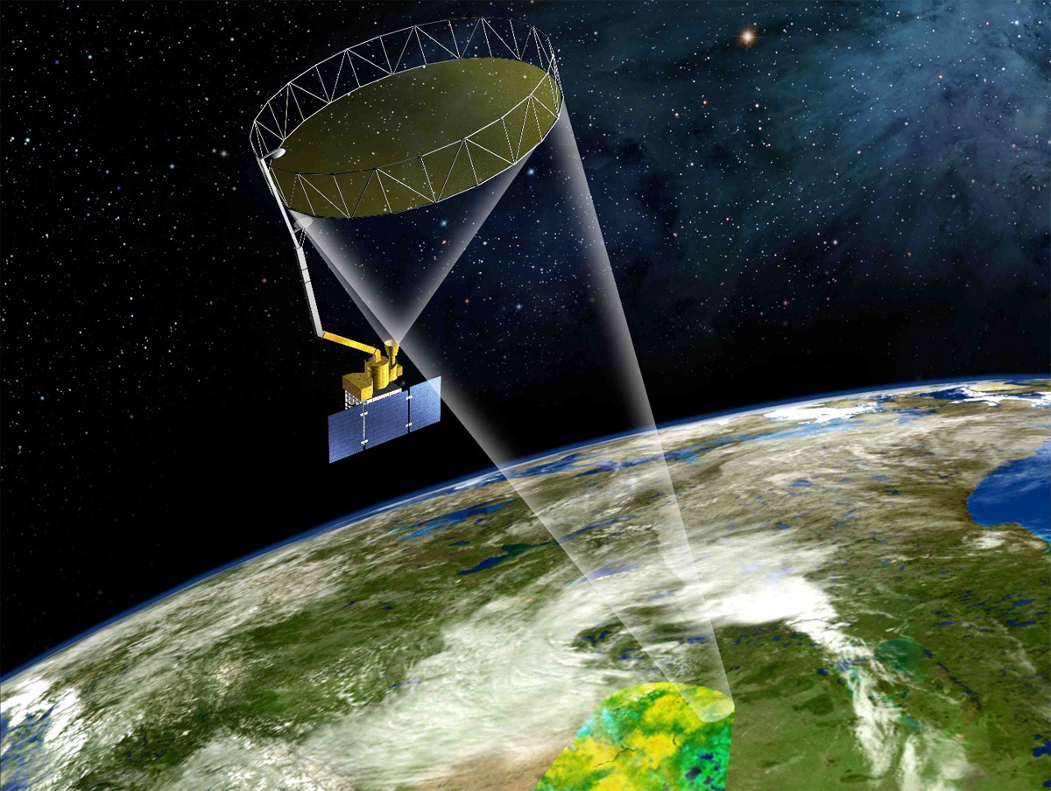
An impact assessment motivated by SMAP
NASA’s Soil Moisture Active Passive (SMAP) mission measures the amount of water in soil everywhere on Earth’s surface
Information collected by SMAP will dramatically improve model predictions and help inform drought monitoring and crop management
SMAP cost $916 million to design, develop, launch, and operate. What can society expect in return for this investment?

Slide 3
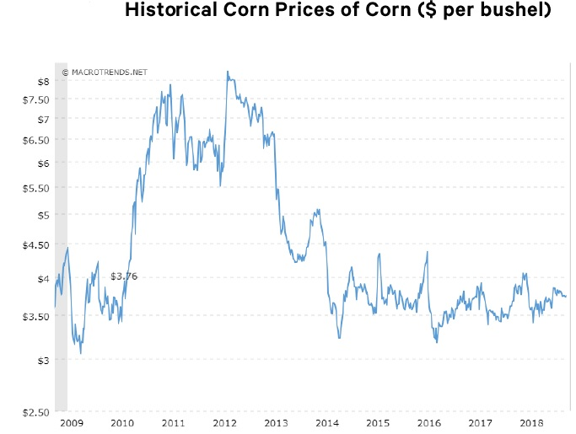
A market-based method
Uncertainty about weather (including soil moisture conditions) is reflected in agricultural risks that are actively traded in large markets
By examining prices in these markets, we can quantify:
  The value of reducing uncertainty in crop yields
  The value of improvements in soil moisture predictions afforded by SMAP data

Slide 4
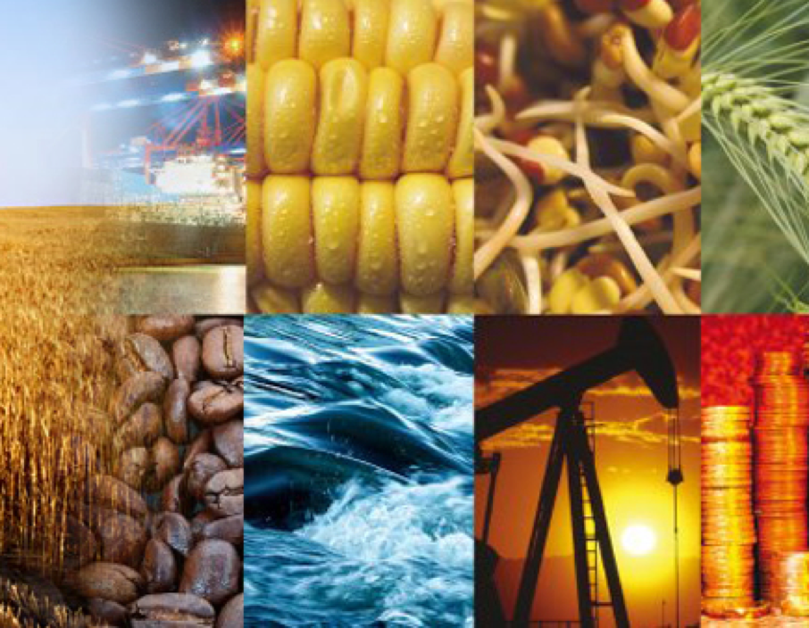
Applying the method to corn and soybean futures markets
Commodities futures markets allow trading of risks between those who will pay to remove a risk and those who will accept payment to assume that risk
As uncertainty about prices and yields increases, so does the price of the futures option
Corn and soybeans are primarily traded on the futures market; low predictability of prices is an important factor of risk for consumers and producers

Slide 5
Quantifying the value of reducing weather uncertainty in two steps
Use pricing models that translate options prices into quantifications of uncertainty
Isolate the contribution of weather uncertainty to uncertainty in prices for corn and soybeans from uncertainty surrounding the overall economy

Slide 6
Results for a 30% reduction in weather-related uncertainty
Earth scientists are still in the process of incorporating SMAP data in predictions of weather-related components that influence corn and soybean yields
Suppose that weather-related uncertainty was reduced by 30 percent thanks to SMAP data
  Given annual US corn production of about 15 billion bushels, the total value of this improved information is about $0.9 billion
  Given annual US soybean production of about 4 billion bushels, the total value of this improved information is about $0.5 billion

Slide 7
Results for other reductions in uncertainty

Slide 8

Thank you.
Learn more: www.rff.org/valuables/impact-assessments/

